Slide 1
Summary of last class
In the last class we discussed
Simplified view of an AVR microcontroller
Internal architecture of AVR
Registers and data memory in AVR
Using instructions with Registers and data memory
Flags register SREG
some AVR Instructions with Data Memory and Registers such as LDS and STS Instructions with SFR or I/O Location like IN and OUT

Slide 2
AVR Data Formats
AVR Data type
The AVR microcontroller has only one data type
It is 8 bits and hence the size of each register is also 8 bits
The data types used by the AVR can be positive or negative

Slide 3
AVR Data Formats(contd..)
Data Format Representation
There are four ways to represent a byte of data in the AVR assembler
The numbers can be in hex, binary, decimal or ASCII formats
Hex numbers: There are two ways to show hex numbers:
(i) Put 0x in front of the number ex. LDI R16, 0x99
(ii) Put $ in front of the number ex. LDI R16, $99

Slide 4
AVR Data Formats(contd..)
Binary numbers: There is only ONE way to represent a byte of data in the AVR assembler ex. LDI R16, 0B1001 1001 or LDI R16, 0b1001 1001
Decimal numbers: To indicate decimal numbers in an AVR assembler we simply use the decimal. Ex. LDI R17, 12
ASCII characters: To represent ASCII data in an AVR assembler we use single quotes. Ex. LDI R23, ‘2’ ; R23 ← 00110010 or 32 in hex

Slide 5
Assembler Directives
Few Directives
.EQU
.DEF
.ORG
.INCLUDE
.SET

Slide 6
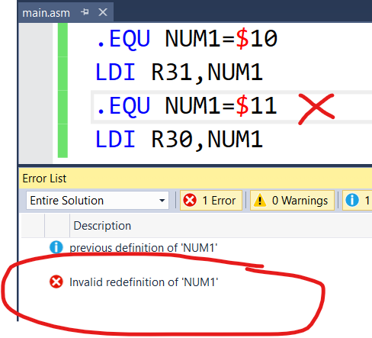
Assembler Directives (.EQU)
.EQU (equate)
Used to define a constant value or a fixed address.
Does not set aside storage for a data item, but associates a constant number with a data or an address label.
Label is substituted by value, when label appears in the program
Example
.EQU COUNT = 0x25
-
-
LDI R21, COUNT ; R21 = 0x25
Value once assigned
cannot be reassigned

Slide 7
Assembler Directives (.EQU)
Using .EQU for fixed data assignment
.EQU DATA1 = 0x39 ;hex
.EQU DATA2 = $39 ;hex
.EQU DATA3 = 0B0011 1001 ; binary
.EQU DATA4 = 39 ; decimal
.EQU DATA5 = ’2’ ;ASCII

Slide 8
Assembler Directives (.EQU)
Using .EQU for SFR address assignment
Ex. .EQU COUNTER = 0x00 ;counter value is 00
.EQU PORTB = 0x18 ; SFR Port B address
LDI R16, COUNTER ; R16 = 0x00
OUT PORTB, R16 ; Port B is now 0x00

Slide 9
Assembler Directives (.EQU)
Using .EQU for RAM address assignment
Ex. .EQU SUM = 0x120
LDI R20, 5
LDI R21, 2
ADD R20, R21
ADD R20, R21
STS SUM, R20

Slide 10
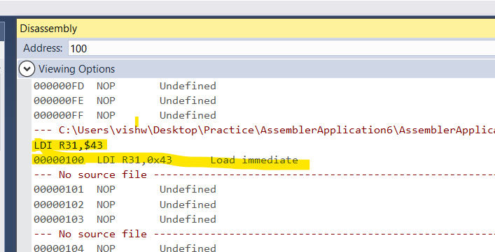
Assembler Directives (.ORG)
.ORG (origin)
Used to indicate the beginning of the address.
Used for both code and data.
Example
.ORG 0X0100
LDI R31,$43

Slide 11
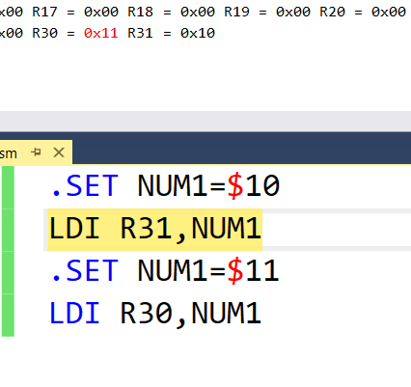
Assembler Directives (.SET)
.SET
Used to define a constant or fixed address
Similar to .EQU ?
But value assigned .SET can be reassigned later in the code

Slide 12
Assembler Directives (.DEF)
.DEF
Example
.DEF num1=R31
.DEF num2=R30
LDI num1,$45
LDI num2,$54
ADD num1,num2

Slide 13
Assembler Directives (.INCLUDE)
.INCLUDE
Includes a file during translation phase
Similar to #include directive in C language
Example (For using Atmega32)
.INCLUDE “M32DEF.INC”

Slide 14
Rules for labels in Assembly language
By choosing label names that are meaningful, a programmer can make a program easier to read and maintain. There are several rules that label names must follow:
Each label name must be unique
The label names in ALP can consist of alphabetic letters both uppercase and lowercase, digits 0 through 9, special characters like ? . @ _ and $.
The first character must be an alphabetic character
Instruction mnemonics like LDI, ADD etc. must not be used as label names as they are reserved words.
You may check your assembler specifications for a list of reserved words.

Slide 15
Structure of Assembly language
An assembly language program or ALP consists of a series of lines of Assembly language instructions
An assembly language instruction consists of a mnemonic, optionally followed by one or two operands.
The operands are the data items being manipulated and the mnemonics are the commands to the CPU, telling it what to do with those items.
An Assembly language instruction consists of 4 fields:
[label:] mnemonic [operands] [;comments]

Slide 16
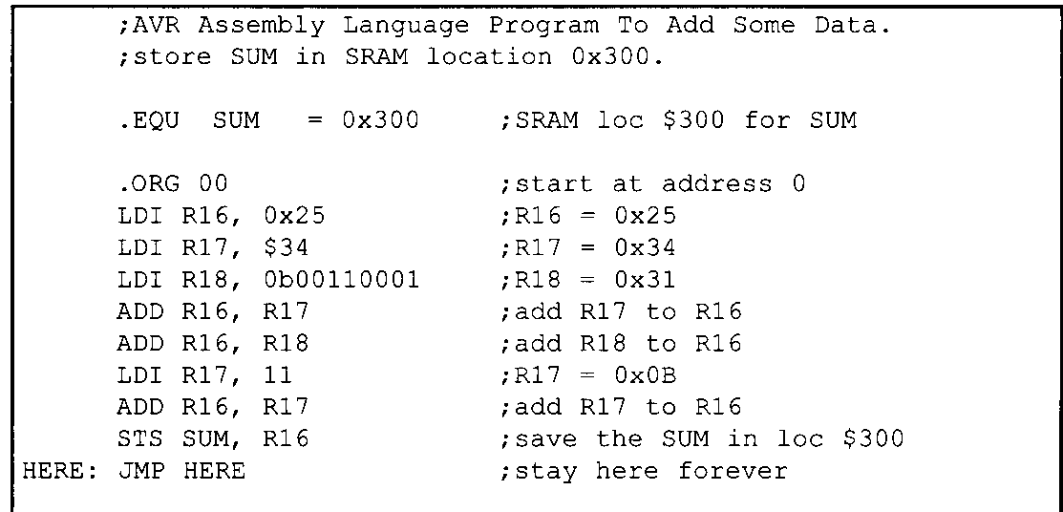
Sample ALP

Slide 17
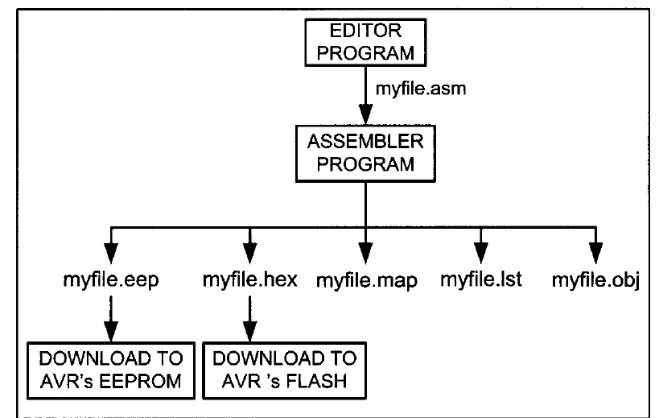
Assembling an AVR Program

Slide 18
File extension | Description
.eep | An EEP file is a data file that stores information on EEPROM (Electrically Erasable Programmable Read-Only Memory) media, such as flash memory. It contains data in a hexadecimal ("hex") format, which defines the contents of the memory device.
.hex | hex file, is a format used to store machine language code in hexadecimal form.
.map | hex file, is a format used to store machine language code in hexadecimal form.
.lst | A listing file shows precisely how the assembler translates your source file into machine code.
.obj | An object file is a computer file containing object code, that is, machine code output of an assembler or compiler.

Slide 19
Assembling an AVR Program
Now that the basic form of an ALP has been given, the next question is: How it is created, assembled and made to run? The steps to create an executable ALP are outlined as follows:

Slide 20
First we use a text editor to type in a program similar to the one we have just written
In the case of AVR microcontrollers we use the AVR studio IDE, which has a text editor, assembler, simulator and much more all in one software package.
The editor must be able to produce an ASCII file
The source file must have an extension .asm

Slide 21
The .asm source file containing the program code created in step 1 is fed to the AVR assembler
The assembler produces an object file (.obj), a hex file (.hex), an eeprom file (.eep), a list file(.lst), and a map file(.map)
After a successful link, the hex file is ready to be burned into the AVR’s program ROM and is downloaded into the AVR Trainer
We can write the eeprom file into the AVR’s EEPROM to initialize the EEPROM.

Slide 22
The .obj file is used as input to a simulator or an emulator
Before we can assemble a program to create a ready-to-run program, we must make sure it is error free
The AVR studio IDE provides us error messages and we examine them to see the nature of syntax errors
The assembler will not assemble the program until all the syntax errors are fixed.

Slide 23
The map file shows the labels defined in the program together with their values The list file shows the binary and source code. It also shows which instructions are used in the source code and the amount of memory the program uses.

Slide 24
Program Counter in the AVR
The PC is the most important register in the AVR microcontroller
The PC contains the address of the next instruction to be executed by the CPU
As the CPU fetches the opcode from the program ROM, the PC is incremented automatically to point to the next instruction
The number of bits in the PC give us an idea of the program ROM space available
That means that a 14-bit program counter can access a maximum of 16K(2¹⁴ = 16K) program memory locations

Slide 25
In AVR microcontroller each Flash memory location is 2 bytes wide.
For example, in Atmega32, whose Flash is 32K bytes, the Flash is organized as 16Kx16 and it’s PC is 14 bits wide
With 32K bytes of on-chip ROM memory, we have 32x1024 = 32,768 bytes and 32,768/2=16,384 locations, which gives addresses ranging from $0000 to $3FFF

Slide 26
We know that the program which is a set of instructions is stored in ROM also called code memory or program memory
You may wonder what is the starting address of the first instruction of the program?
In other words what is the Power up status of AVR microcontroller?
In the case of AVR microcontroller (all members, regardless of family and variation) on power up it expects the first opcode to be stored at ROM address $0000.
That is the PC content is $0000
After the program is burned into ROM of an AVR family member the opcode and operand are placed in ROM memory locations starting from $0000 and is listed in the .lst file in binary (machine code)

Slide 27
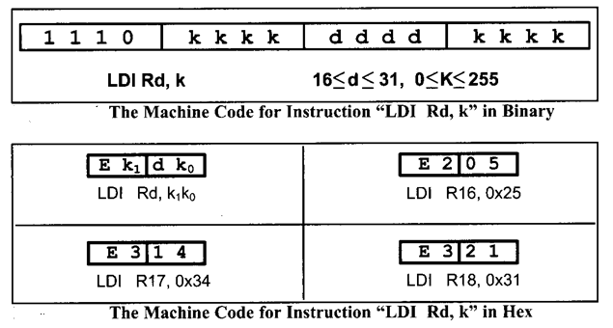
For example when you debug and run your program using the AVR studio IDE, you see the .lst or the list file containing the machine code of your program . Let us understand how to write machine code for an instruction say LDI Rd, k where d ranges from 16 to 31 and k is from 0 to 255 (FF H). This instruction occupies 2 bytes of memory and it’s format is

Slide 28
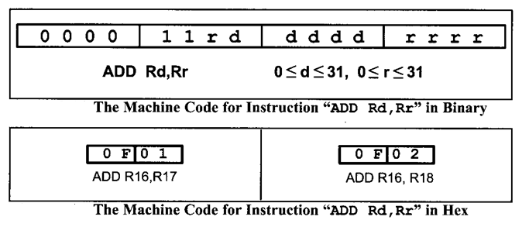
In this way we can write the machine code for all instructions in the program. But this translation is not done by the programmer. It is done by the assembler and it is seen in the .lst or list file.

Slide 29
Increasing the processing power of the CPU
1. Increase the clock frequency of the chip. One drawback of this method is that the higher the frequency, the more power and heat dissipation. Power and heat dissipation is especially a problem for hand-held devices.

Slide 30
2. Use Harvard architecture by increasing the number of buses to bring more information (code and data) into the CPU to be processed.
3. Change the internal architecture of the CPU and use what is called RISC architecture.
Atmel used all three methods to increase the processing power of the AVR microcontrollers.

Slide 31
Features of RISC
The following are some of the features of RISC as implemented by the AVR microcontroller.
Feature I
RISC processors have a fixed instruction size.
If the instruction size is variable the task of the instruction decoder is very difficult because the size of the incoming instruction is never known. In a RISC architecture, the size of all instructions is fixed. Therefore, the CPU can decode the instructions quickly.

Slide 32
Feature 2
RISC architecture have a large number of registers.
One advantage of a large number of registers is that it avoids the need for a large stack to store parameters.
In the AVR microcontrollers the use of 32 general purpose registers satisfies this RISC feature.

Slide 33
Feature 3
RISC processors have a small instruction set. RISC processors have only basic instructions such as ADD, SUB, MUL, LOAD, STORE, AND, OR, EOR, CALL, JUMP, and so on.
The limited number of instructions in RISC leads to programs that are large. Although these programs can use more memory, this is not a problem because memory is cheap.
In the ATmega we have around 130 instructions.

Slide 34
Feature 4
The most important characteristic of the RISC processor is that more than 95% of instructions are executed with only one clock cycle, in contrast to CISC instructions.

Slide 35
Feature 5
RISC processors have separate buses for data and code.
In RISC processors, there are four sets of buses:
a set of data buses for carrying data (operands) in and out of the CPU,
a set of address buses for accessing the data,
a set of buses to carry the opcodes, and
a set of address buses to access the opcodes. The use of separate buses for code and data operands is characteristic of Harvard architecture.

Slide 36
Feature 6
RISC instructions, however, due to the small set of instructions, are implemented using the hardwire method. Hardwiring of RISC instructions takes only 10% of the transistors that are used in CISC

Slide 37
Feature 7
RISC uses load/store architecture.
In RISC, instructions can only load from external memory into registers or store registers into external memory locations.
There is no direct way of doing arithmetic and logic operations between a register and the contents of external memory locations.

Slide 38
All these instructions must be performed by first bringing both operands into the registers inside the CPU, then performing the arithmetic or logic operation, and then sending the result back to memory.
This idea was first implemented by the Cray 1 supercomputer in 1976 and is commonly referred to as load/store architecture.

